Slide 1


Slide 2

DPU-Smart Traffic box
Version 0.1

Slide 3

Agenda
Introduction
Purpose
Objective
Development Process
Protection and Licensing
Technology and Tools
Timeline
Risk management
Conclusion

Slide 4
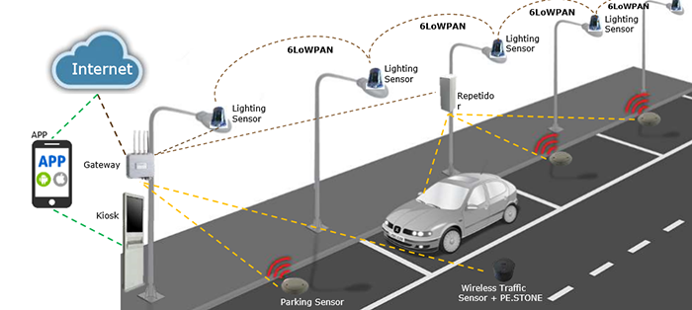
1. Introduction
FPGA-edge module for on-device ANPR from parking and roadside cameras.
Outputs plate text, timestamp and confidence score, sending results to the backend to slash storage needs and eliminate manual logging.
v0.1 targets indoor parking and still image (one vehicle per frame).

Slide 5
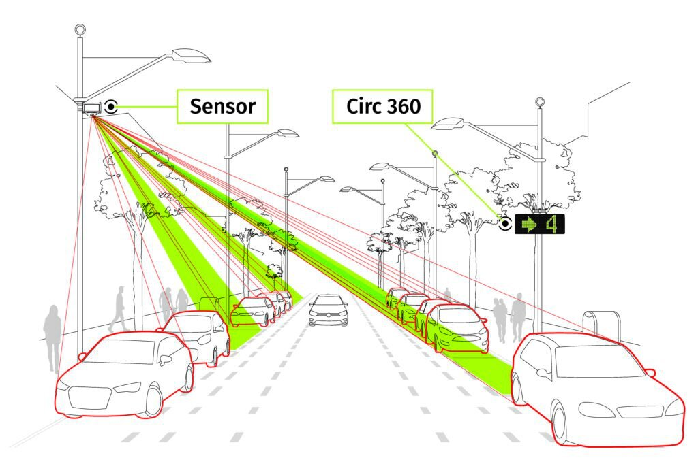
2. Purpose
Replace labor-intensive parking‑lot plate logging and complex operating systems with a compact FPGA solution.
Transmit only essential plate data—minimizing storage and bandwidth.
Provide a roadmap toward speed‑enforcement and red‑light violation analysis.

Slide 6
3. Objective
Item | Target
Plate‑reading accuracy | ≥ 95% on indoor still images
Processing latency | ≤ 200 ms per image
Packet‑loss tolerance | < 3% (image + metadata)
Power endurance | ≥ 2 years continuous on battery or working with plug power
Operating environment | 0–50°C nominal; –1 → 60°C surge; IP‑65

Slide 7
4. Project phase
Phase 1: Algorithms and ML research
Phase 2: Hardware implementation
Phase 3: Verification and validation

Slide 8
Phase 1: Specification research
Data estimation and preparation
Model evaluation and selection
Resource and License Assessment
Software Demo Visualization

Slide 9
Phase 2: Hardware implementation
Top-Level Architecture design
RTL Implementation
Optimization
Synthesis & Place-and-Route
Board Programming & Virtual Test
Verification document and strategy

Slide 10
Phase 3: Verification and Validation
Using Simulator to ensure the function
Re-implementation and verification
Conduct all conditions to re-verify the function
Conduct compression testing to check the limit of the application for final expectation

Slide 11

5. Protection and Licensing
Once a design is finalized and validated, file for patents to protect the intellectual property.
Create documentation and support tools to facilitate integration and licensing.
Develop licensing strategies to market and distribute the IP to interested parties.

Slide 12
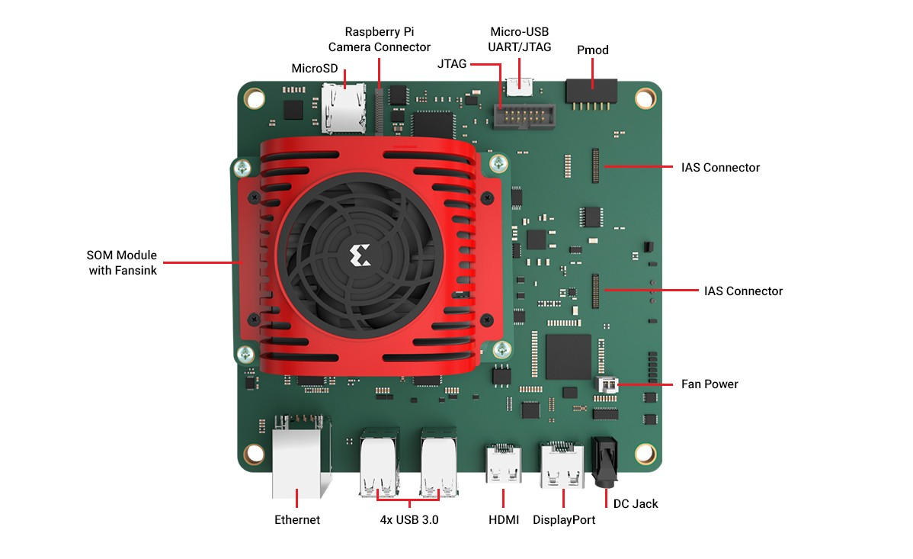
6. Technology and tool
FPGA with DPU
ESP32 Cam board with camera
Machine learning algorithms for plate detection and OCR in fully RTL implementation
Vitis-AI
Vivado

Slide 13
7. Timeline
1-3/2025: Market research, requirements gathering, and initial implementation.
4-8/2025: Develop, testing and evaluation version 0.1
9-12/2025: Update to version 0.2
12/2025: IP licensing and documentation
1/2026: Ready to launch Version 1.0
1-10/2026: Launch version 1.0 while develop version 1.1 and 1.2
10/2026: IP licensing and documentation
11-12/2026: Launch version 2.0 and develop new feature in background

Slide 14
8. Risk management
Technical Risk: Potential challenges in achieving the desired performance or overcoming design constraints. Mitigation: Frequent design reviews and prototyping to minimize unexpected outcomes.
Market Risk: Difficulty in finding licensees or customers. Mitigation: Engage with industry partners early in the design process and explore different licensing models.
Financial Risk: Budget overruns due to unforeseen design or prototyping challenges. Mitigation: Regular project monitoring and contingency planning.

Slide 15

9. Conclusion
Development of DPU-Smart traffic box
Still working on new product for multiple applications
Future releases will add live multi-vehicle tracking, night-vision, outdoor violation analytics and highway-speed operation based on customer need

Slide 16


